Slide 1
28-Homobrassinolide- CIPAC Full Scale Collaborative Study
CIPAC technical meeting 2021
Jason Zhang (Chinese Pesticide Advisory Committee, CHIPAC)
Method developed by Jiangxi Windeal Biotechnology Co., Ltd.

Slide 2
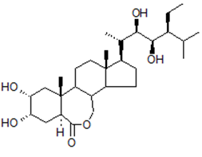
GENERAL INFORMATION
Common name | 28-Homobrassinolide
Chemical Name | (5S,6R)-10-((2S,3R,4R,5S)-5-ethyl-3,4-dihydroxy-6-methylheptan-2-yl)-5,6-dihydroxy-7a,9a-dimethyltetradecahydro-1H-benzo[c]indeno[5,4-e]oxepin-3(12bH)-one
Empirical formula | C₂₉H₅₀O₆
CAS No. | 82373-95-3
Structure
RMM | 494.8
m.p. | 256~257°C
Solubility (g/L, 20℃) | In water 5mg/l, acetonitrile 1.3g/l, ethanol 5.2g/l, methanol 2.7g/l at 20 °C.
Description | White powder
Stability | Stable in neutral and weak alkaline condition but hydrolysed in acidic conditions
Formulation | Emulsifiable concentrates, soluble concentrates

Slide 3
BACKGROUND OF THE STUDY
In February 2020, small scale collaboration was initiated.
Two technical samples, two SL samples and one EC sample were sent to the following 6 participants in February 2020.
The report of small scale collaboration was discussed and passed on virtual CIPAC meeting last year.
Lab No. | Name of responsible person | Lab Name | Country
1 | Liu ShuZhen | Jiangxi Windeal Biotechnology Co., Ltd. - Quality Department | Jiangxi, China
2 | Sun Fengying | Kaifeng Yitian Biotechnology Co., Ltd. - quality control department | Henan, China
3 | Chen Mirror | GreenTech Laboratory Co., Ltd. | Shanghai, China
4 | Mei Quanfu | Jiangxi Buffett Chemical Co., Ltd. - quality control department | Jiangxi, China
5 | Chang Feng | Shandong Huihan Biotechnology Co., Ltd. - analysis room | Shandong, China
6 | Liu Xinsheng | Guangdong Zhongxun Agricultural Technology Co., Ltd. - PTD Center | Guangdong, China

Slide 4
PARTICIPANTS
Two technical samples, two SL samples and one EC sample were sent to 18 participants in November 2020.
By the end of April 2021, 16 participants provided their results, another 2 participants did not reply in time.
 | Name of responsible person | Lab Name | City, Country
1 | Helen Karasali | Benaki Phytopathological Institute | Greece
2 | Denis Carr | Department of Agriculture, Food and the Marine | Ireland
3 | Wendy Wang | Jiangsu Agrochem Laboratory Co., Ltd. | China
4 | Cornel Grecu | Laboratory of Alchimex | Romania
5 | Angela Santilio | National Institute of Health – Department of Environment and Health – ECASS Section | Italy
6 | Huang Liang | Anhui Fengle Agrochemical Co., Ltd. Product Testing Center | Auhui, China

Slide 5
 | Name of responsible person | Lab Name | City, Country
7 | UENO Takanori | Agricultural Chemicals Inspection Station, Food and Agricultural Materials Inspection Center | Japan
8 | Vanessa Lecocq | Walloon Agricultural Research Centre (CRA-W) Knowledge and Valorization of Products Department (D4) Protection, control products and residues Unit (U10) | Belgium
9 | Zhang Juntao | Helm China Co., Ltd. | China
10 | Xu Aiping | Laprode (Zhejiang) Analysis Co., Ltd | Zhejiang, China
11 | Agus Salim | Laboratorium PT Agriculture Construction (AGRICON) | Indonesia
12 | He Zhiyu | Guizhou JAD technology co., LTD | Guizhou, China
13 | Chang Feng | Shandong Huihan Biotechnology Co., Ltd. - analysis room | Shandong, China
14 | Sun Fengying | Kaifeng Yitian Biotechnology Co., Ltd. - quality control department | Henan, China
15 | Liu Xinsheng | Guangdong Zhongxun Agricultural Technology Co., Ltd. - PTD Center | Guangdong, China
16 | Liu ShuZhen | Jiangxi Windeal Biotechnology Co., Ltd. - Quality Department | Jiangxi, China

Slide 6
Analytical Method
Outline of Method
After derivatization with Phenylboronic Acid, the 28-Homobrassinolide content of the samples is determined by high performance liquid chromatography on ODS-C18 film stainless column with UV detector at 220 nm, quantified by external standard method.
Column: | 250mm x 4.6 mm (id), packed with ODS-C18, or equivalent | Eluent: | acetonitrile+ water = 80 + 20（v/v）
Column Temperature: | 25℃ | Flow Rate: | 1.0 ml/min
Detector Wavelength： | 220nm | Injection Volume: | 10μL
Retention time: | Approximately 18.6min

Slide 7
Analytical Method
Preparation of the test substance solution and determination （TC）
Preparation of standard solution: prepare standard solution in duplicate. Weigh 0.01g (to the nearest 0.1mg) 28-Homobrassinolide standard into 25ml volumetric flask, dissolved by 15ml methanol. Add 4ml phenylboronic acid solution (6mg/ml phenylboronic acid was prepared with methanol before), react 30min in thermostat at 50℃. Allow the solution to cool to ambient temperature and fill to the mark with methanol. Mix thoroughly and place the flask in an ultrasonic bath for 5 min, then filter the solution through a 0.45μm filter membrane prior to analysis.
Preparation of sample solution: prepare sample solution in duplicate. Weigh (to the nearest 0.1mg) sufficient sample to contain about 10mg 28-Homobrassinolide into 25ml volumetric flask, dissolved by 15ml methanol. Add 4ml phenylboronic acid solution, react 30min in thermostat at 50℃. Allow the solution to cool to ambient temperature and fill to the mark with methanol. Mix thoroughly and place the flask in an ultrasonic bath for 5 min, then filter the solution through a 0.45μm filter membrane prior to analysis. (Sample solutions S1 and S2)
Determination: Inject in duplicate 10μL portions of each sample solution bracketing them by injections of the calibration solutions as follows: C_{A}, S₁, S₁, C_{B}, S₂, S₂, C_{A}, etc.

Slide 8
Analytical Method
Preparation of the test substance solution and determination （SL）
Preparation of standard solution: prepare standard solution in duplicate. Weigh 0.01g (to the nearest 0.1mg) 28-Homobrassinolide standard into 25ml volumetric flask, dissolved by 15ml methanol. Add 4ml phenylboronic acid solution, react 30min in thermostat at 50℃. Allow the solution to cool to ambient temperature and fill to the mark with methanol. Mix thoroughly and add 1ml solution into 10ml volumetric flask by pipette and fill to the mark with methanol. Mix thoroughly and place the flask in an ultrasonic bath for 5 min, then filter the solution through a 0.45μm filter membrane prior to analysis.
Preparation of sample solution: prepare sample solution in duplicate. Weigh (to the nearest 0.1mg) sufficient sample to contain about 1mg 28-Homobrassinolide into 25ml volumetric flask. Add 4ml phenylboronic acid solution, react 30min in thermostat at 50℃. Allow the solution to cool to ambient temperature and fill to the mark with methanol. Mix thoroughly and place the flask in an ultrasonic bath for 5 min, then filter the solution through a 0.45μm filter membrane prior to analysis.

Slide 9
Analytical Method
Preparation of the test substance solution and determination （EC）
Preparation of standard solution: prepare standard solution in duplicate. Weigh 0.01g (to the nearest 0.1mg) 28-Homobrassinolide standard into 25ml volumetric flask, dissolved by 15ml methanol. Add 4ml phenylboronic acid solution, react 30min in thermostat at 50℃. Allow the solution to cool to ambient temperature and fill to the mark with methanol. Mix thoroughly and add 1ml solution into 10ml volumetric flask by pipette and fill to the mark with methanol. Mix thoroughly and place the flask in an ultrasonic bath for 5 min, then filter the solution through a 0.45μm filter membrane prior to analysis.
Preparation of sample solution: prepare sample solution in duplicate. Weigh (to the nearest 0.1mg) sufficient sample to contain about 1mg 28-Homobrassinolide into 25ml volumetric flask, dissolved by 5ml methanol. Add 4ml phenylboronic acid solution, react 30min in thermostat at 50℃. Allow the solution to cool to ambient temperature and fill to the mark with methanol. Mix thoroughly and place the flask in an ultrasonic bath for 5 min, then filter the solution through a 0.45μm filter membrane prior to analysis.

Slide 10
Study format
Samples
28-Homobrassinolide Technical (SAMPLE A)
28-Homobrassinolide Technical (SAMPLE B)
28-Homobrassinolide Soluble Liquid (SAMPLE C)
28-Homobrassinolide Soluble Liquid (SAMPLE D)
28-Homobrassinolide Emulsifiable Concentrate (SAMPLE E)
Protocol
The samples were analyzed on two different days, each day involving duplicate injections of duplicate weights. Test and calibration solutions were prepared fresh on each day. The sample content was calculated using the mean value of the duplicate injections.

Slide 11
Analytical conditions
Lab Number | Analytical Conditions
Laboratory 1 | Column: SHIMADZU, Luna 5μm C18, 250 x 4.6 mm, Phenomenex S/N: Η19-029626 Remarks: Flow rate was increased from 1ml/min to 1.3 ml/min.
Laboratory 2 | Column: SHIMADZU, Inertsil ODS-C18, 250mm x 4.6mm, 3µm Remarks: The particle size of the HPLC column used was 3µm.
Laboratory 3 | Column: Agilent 250mm*4.6mm (id), packed with ZORBAX SB-C18, 5μm Remarks: None
Laboratory 4 | Column: AkzoNobel, Kromasil 100-5C18 250 x 4.6mm, batch no. E95557 Remarks: None
Laboratory 5 | Column: RESTEK Roc C18 5 um; 250 x 4.6 mm Remarks: None
Laboratory 6 | Column: ODS-3 (Inertsil) 4.6mm*250mm*5μm, C/N.5020-01732 S/N.1A7184863 Remarks: None
Laboratory 7 | Column: NUCLEOSIL 5C18 (250 mm X 4.6 mm, particle size 5 µm, Column No. L7A44) Remarks: None
Laboratory 8 | Column: Agilent Zorbax SB-C18, 5 µm, 250 mm x 4.6 mm, Batch # B07021 Remarks: Flow rate was increased from 1ml/min to 1.5 ml/min.
Laboratory 9 | Column: SHIMADZU Shim-pack VP-ODS C18 250 mm x 4.6 mm Remarks: None

Slide 12
Laboratory 10 | Column: Agilent Eclipse Plus C18 ( 4.6mm*250mm*5µm ) Remarks: None
Laboratory 11 | Column: Phenomenex Gemini NX-C18 110 Å, 250 x 4.6 mm (i.d) , particle size 5 µm, S/No : H19-280905, Part No : OOG-4454-E0 Remarks: Flow rate was increased from 1ml/min to 1.4 ml/min.
Laboratory 12 | Column: GL Sciences Inertsil ODS-SP,250 mm×4.6 mm,5 μm Remarks: Change the column temperature to 30℃.
Laboratory 13 | Column: Agilent 5 TC-C18(2) 250×4.6mm Remarks: None
Laboratory 14 | Column: Elliot, 4.6mm×250mm E2616571 Remarks: None
Laboratory 15 | Column: XTERRA MS c18, 4.60mm*250cm, 03273926014075 Remarks: None
Laboratory 16 | Column: SHIMADZU, 4.6×250mm, 8FR98171 Remarks: None

Slide 13
Deviations
Flow rate
3 labs adjusted the flow rate to 1.3 ml/min, 1.4 ml/min and 1.5 ml/min respectively (Lab 1, Lab 8 and Lab 11)
Column temp.
3 labs adjusted the column temp. to 30 degree （Lab 4, Lab 9, Lab 12）
Column
3μm particle size was used in Lab 2

Slide 14
DATA Evaluation and Discussion
ORINGINAL DATA (g/kg)
 | 28-Homobrassinolide Sample A |  | 28-Homobrassinolide Sample B |  | 28-Homobrassinolide Sample C |  | 28-Homobrassinolide Sample D |  | 28-Homobrassinolide Sample E
 | Day1 | Day2 | Day1 | Day2 | Day1 | Day2 | Day1 | Day2 | Day1 | Day2
Laboratory 1 | 954.8 | 953.4 | 930.7 | 949.6 | 0.047 | 0.048 | 0.055 | 0.056 | 0.127 | 0.126
Laboratory 2 | 930.9 | 966.2 | 944.3 | 1000.7 | 0.051 | 0.053 | 0.051 | 0.054 | 0.097 | 0.111
Laboratory 3 | 952.0 | 957.0 | 951.9 | 951.5 | 0.039 | 0.039 | 0.042 | 0.042 | 0.097 | 0.096
Laboratory 4 | 947.0 | 945.8 | 944.4 | 948.7 | 0.043 | 0.042 | 0.049 | 0.048 | 0.105 | 0.105
Laboratory 5 | 870.9 | 923.6 | 885.9 | 951.0 | 0.050 | 0.050 | 0.050 | 0.060 | 0.120 | 0.120
Laboratory 6 | 951.7 | 951.1 | 952.3 | 952.5 | 0.033 | 0.032 | 0.040 | 0.041 | 0.088 | 0.087

Slide 15
 | 28-Homobrassinolide Sample A |  | 28-Homobrassinolide Sample B |  | 28-Homobrassinolide Sample C |  | 28-Homobrassinolide Sample D |  | 28-Homobrassinolide Sample E
 | Day1 | Day2 | Day1 | Day2 | Day1 | Day2 | Day1 | Day2 | Day1 | Day2
Laboratory 7 | 943.8 | 939.1 | 941.8 | 943.0 | 0.034 | 0.033 | 0.039 | 0.038 | 0.086 | 0.083
Laboratory 8 | 966.6 | 966.7 | 949.7 | 933.4 | 0.038 | 0.038 | 0.048 | 0.045 | 0.096 | 0.093
Laboratory 9 | 953.4 | 954.9 | 953.1 | 954.3 | 0.035 | 0.035 | 0.042 | 0.042 | 0.089 | 0.090
Laboratory 10 | 947.9 | 936.7 | 950.1 | 945.2 | 0.033 | 0.033 | 0.040 | 0.040 | 0.085 | 0.085
Laboratory 11 | 950.0 | 946.3 | 947.2 | 947.3 | 0.039 | 0.038 | 0.046 | 0.043 | 0.091 | 0.090
Laboratory 12 | 947.7 | 947.0 | 934.8 | 934.1 | 0.032 | 0.032 | 0.040 | 0.038 | 0.070 | 0.073
Laboratory 13 | 953.0 | 950.7 | 953.1 | 952.1 | 0.040 | 0.040 | 0.040 | 0.040 | 0.100 | 0.100
Laboratory 14 | 952.4 | 954.2 | 952.0 | 953.9 | 0.042 | 0.040 | 0.042 | 0.040 | 0.101 | 0.101
Laboratory 15 | 955.7 | 953.8 | 951.7 | 953.9 | 0.040 | 0.041 | 0.040 | 0.041 | 0.102 | 0.102
Laboratory 16 | 952.7 | 956.6 | 954.0 | 952.6 | 0.040 | 0.041 | 0.040 | 0.041 | 0.101 | 0.101

Slide 16
DATA EVALUATION AND DISCUSSION
MEAN VALUES (g/kg)
 | 28-Homobrassinolide SAMPLE A | 28-Homobrassinolide SAMPLE B | 28-Homobrassinolide SAMPLE C | 28-Homobrassinolide SAMPLE D | 28-Homobrassinolide SAMPLE E
Laboratory 1 | 954.1 | 940.2 | 0.048 | 0.056 | 0.127
Laboratory 2 | 948.6 | 972.5 | 0.052 | 0.053 | 0.104
Laboratory 3 | 954.5 | 951.7 | 0.039 | 0.042 | 0.097
Laboratory 4 | 946.4 | 946.6 | 0.043 | 0.049 | 0.105
Laboratory 5 | 897.2 ^{+/++} | 918.4 ⁺ | 0.050 | 0.055 | 0.120
Laboratory 6 | 951.4 | 952.4 | 0.033 | 0.041 | 0.088
⁺ Gubbs Test straggler
⁺⁺ Gubbs Test outlier

Slide 17
 | 28-Homobrassinolide SAMPLE A | 28-Homobrassinolide SAMPLE B | 28-Homobrassinolide SAMPLE C | 28-Homobrassinolide SAMPLE D | 28-Homobrassinolide SAMPLE E
Laboratory 7 | 941.5 | 942.4 | 0.034 | 0.039 | 0.085
Laboratory 8 | 966.7 | 941.6 | 0.038 | 0.047 | 0.095
Laboratory 9 | 954.2 | 953.7 | 0.035 | 0.042 | 0.090
Laboratory 10 | 942.3 | 947.7 | 0.033 | 0.040 | 0.085
Laboratory 11 | 948.2 | 947.3 | 0.039 | 0.045 | 0.091
Laboratory 12 | 947.4 | 934.5 | 0.032 | 0.039 | 0.072
Laboratory 13 | 951.9 | 952.6 | 0.040 | 0.040 | 0.100
Laboratory 14 | 953.3 | 953.0 | 0.041 | 0.041 | 0.101
Laboratory 15 | 954.8 | 952.8 | 0.041 | 0.041 | 0.102
Laboratory 16 | 954.7 | 953.3 | 0.041 | 0.041 | 0.101

Slide 18
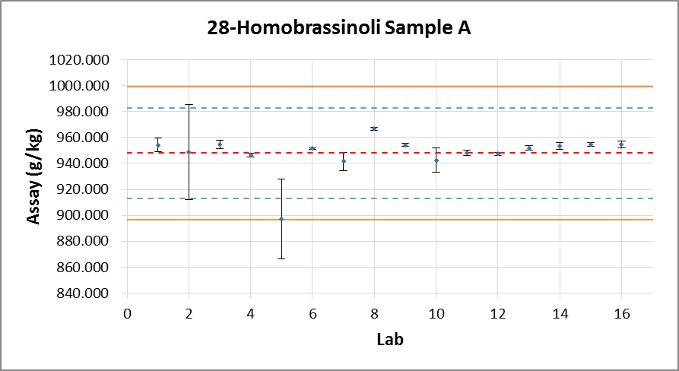
DATA Evaluation and Discussion
Xm | 947.9
L | 16
Sr | 11.516
S_{R} | 16.849
r | 32.245
R | 47.177
RSDr | 1.215
RSDR | 1.777
RSDR(Hor) | 2.016
HorRat | 0.882
Fig. 1 – 28-Homobrassinolide Sample A with outliers /stragglers

Slide 19
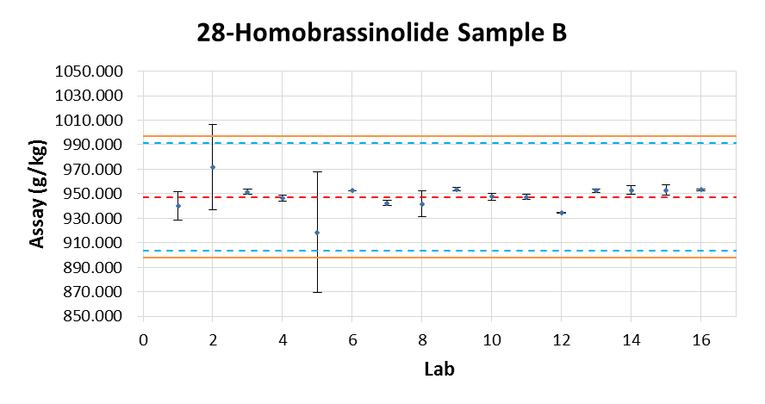
Xm | 947.5
L | 16
Sr | 15.909
S_{R} | 16.024
r | 44.545
R | 44.867
RSDr | 1.679
RSD_{R} | 1.691
RSD_{R}(Hor) | 2.016
HorRat | 0.839
Fig. 2 – 28-Homobrassinolide Sample B with outliers /stragglers

Slide 20
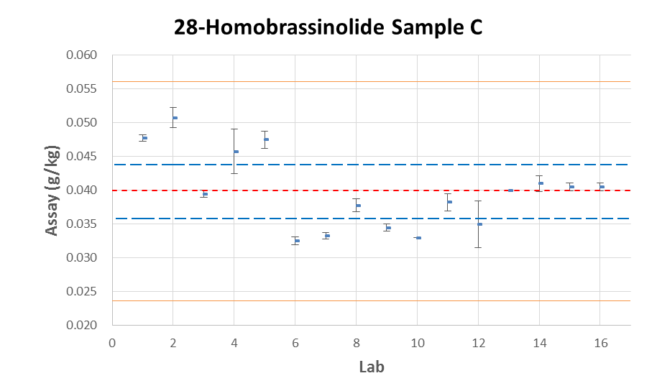
Xm | 0.040
L | 16
Sr | 0.00069
S_{R} | 0.00608
r | 0.00193
R | 0.01702
RSDr | 1.724
RSD_{R} | 15.300
RSD_{R}(Hor) | 9.193
HorRat | 1.664
Fig. 3 – 28-Homobrassinolide Sample C

Slide 21
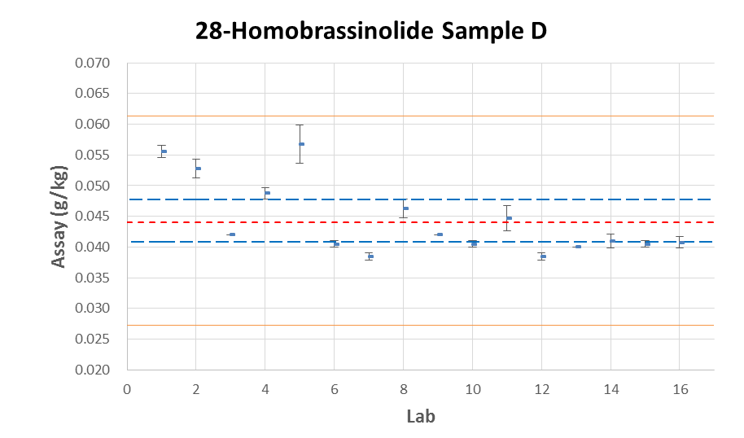
Xm | 0.044
L | 16
Sr | 0.00592
S_{R} | 0.00592
r | 0.01658
R | 0.01658
RSDr | 4.754
RSD_{R} | 13.410
RSD_{R}(Hor) | 9.047
HorRat | 1.482
Fig. 4 – 28-Homobrassinolide Sample D

Slide 22
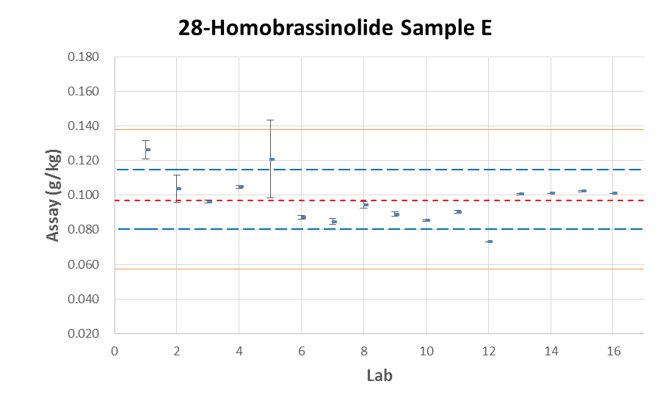
Xm | 0.097
L | 16
Sr | 0.00267
S_{R} | 0.01360
r | 0.00748
R | 0.03808
RSDr | 2.739
RSD_{R} | 13.958
RSD_{R}(Hor) | 8.031
HorRat | 1.738
Fig. 5 – 28-Homobrassinolide Sample E

Slide 23
Summary
Summary of the statistical evaluation with outliers /stragglers
 | sample A | sample B | sample C | sample D | sample E
Xm | 947.9 | 947.5 | 0.040 | 0.044 | 0.097
L | 16 | 16 | 16 | 16 | 16
Sr | 11.516 | 15.909 | 0.00069 | 0.00592 | 0.00267
S_{R} | 16.849 | 16.024 | 0.00608 | 0.00592 | 0.01360
r | 32.245 | 44.545 | 0.00193 | 0.01658 | 0.00748
R | 47.177 | 44.867 | 0.01702 | 0.01658 | 0.03808
RSDr | 1.215 | 1.679 | 1.724 | 4.754 | 2.739
RSD_{R} | 1.777 | 1.691 | 15.300 | 13.410 | 13.958
RSD_{R}(Hor) | 2.016 | 2.016 | 9.193 | 9.047 | 8.031
HorRat | 0.882 | 0.839 | 1.664 | 1.482 | 1.738
Xm = average
L = number of laboratories
S_{r} = repeatability standard deviation
S_{R} = reproducibility standard deviation
RSD_{r} = repeatability relative standard deviation
RSD_{R} = reproducibility relative standard deviation
r = repeatability
R = reproducibility
RSD_{R} (Hor) = Horwitz value calculated from: 2^(1 - 0.5log c) where c = the concentration of the analyte as a decimal fraction

Slide 24
Summary of the statistical evaluation without stragglers
 | sample A | sample B | sample C | sample D | sample E
Xm | 947.7 | 947.5 | 0.040 | 0.044 | 0.097
L | 15 | 16 | 16 | 16 | 16
Sr | 11.893 | 15.909 | 0.00069 | 0.00592 | 0.00267
S_{R} | 17.404 | 16.024 | 0.00608 | 0.00592 | 0.01360
r | 33.300 | 44.545 | 0.00193 | 0.01658 | 0.00748
R | 48.731 | 44.867 | 0.01702 | 0.01658 | 0.03808
RSDr | 1.255 | 1.679 | 1.724 | 4.754 | 2.739
RSD_{R} | 1.836 | 1.691 | 15.300 | 13.410 | 13.958
RSD_{R}(Hor) | 2.016 | 2.016 | 9.193 | 9.047 | 8.031
HorRat | 0.911 | 0.839 | 1.664 | 1.482 | 1.738
Xm = average
L = number of laboratories
S_{r} = repeatability standard deviation
S_{R} = reproducibility standard deviation
RSD_{r} = repeatability relative standard deviation
RSD_{R} = reproducibility relative standard deviation
r = repeatability
R = reproducibility
RSD_{R} (Hor) = Horwitz value calculated from: 2^(1 - 0.5log c) where c = the concentration of the analyte as a decimal fraction
Sample A Results of Lab 5 eliminated.

Slide 25
Summary of the statistical evaluation without outliers
 | sample A | sample B | sample C | sample D | sample E
Xm | 947.7 | 947.2 | 0.040 | 0.044 | 0.097
L | 15 | 15 | 16 | 16 | 16
Sr | 11.893 | 16.431 | 0.00069 | 0.00592 | 0.00267
S_{R} | 17.404 | 16.513 | 0.00608 | 0.00592 | 0.01360
r | 33.300 | 46.007 | 0.00193 | 0.01658 | 0.00748
R | 48.731 | 46.236 | 0.01702 | 0.01658 | 0.03808
RSDr | 1.255 | 1.735 | 1.724 | 4.754 | 2.739
RSD_{R} | 1.836 | 1.743 | 15.300 | 13.410 | 13.958
RSD_{R}(Hor) | 2.016 | 2.016 | 9.193 | 9.047 | 8.031
HorRat | 0.911 | 0.865 | 1.664 | 1.482 | 1.738
Xm = average
L = number of laboratories
S_{r} = repeatability standard deviation
S_{R} = reproducibility standard deviation
RSD_{r} = repeatability relative standard deviation
RSD_{R} = reproducibility relative standard deviation
r = repeatability
R = reproducibility
RSD_{R} (Hor) = Horwitz value calculated from: 2^(1 - 0.5log c) where c = the concentration of the analyte as a decimal fraction
Sample A Results of Lab 5 eliminated, Sample B Results of Lab 5 eliminated.

Slide 26
conclusions
For TC samples, the values of RSDR (reproducibility relative standard deviation) were less than Horwitz’s value. As a reference, the HorRat values for TC were not greater than 1.0.
For SL and EC samples, all HorRat values were not greater than 2.0. Considering very low concentration of SL and EC sample and no outliers or stragglers were detected in Grubbs test, the result is acceptable.
No more than one value has been removed per sample. The validity of the results and the suitability of the analytical method are shown.
This collaborative trial is acceptable.

Slide 27
Thanks for your attention!

